Slide 1



Major Project Review
MATRUSRI ENGINEERING COLLEGE
Department of CSE
Enhancing Data Security in the Cloud with Semi-Trusted Third-Party Involvement.
Project Batch Number: A17
Project Guide : Mrs. B Sonal, Assistant professor
Serial No | Student Name | Roll No
1 | Vaspari Tharun Kumar | 1608-20-733-022
2 | Lekhana Sarikonda | 1608-20-733-012
3 | Nagalla Lohith | 1608-20-733-303

Slide 2
Contents
MATRUSRI ENGINEERING COLLEGE
Department of CSE
Introduction
Motivation
Abstract
Problem Statement
Literature Survey
Objectives
Proposed Methodology
Modules
System Requirements
System Architecture
UML Diagrams
Results
Conclusion
References

Slide 3
Introduction
MATRUSRI ENGINEERING COLLEGE
Department of CSE
The advent of cloud computing has revolutionized data storage and sharing, enabling individuals and organizations to leverage scalable and cost-effective solutions. However, the outsourcing of data to the cloud introduces concerns about privacy and integrity, particularly when multiple parties collaborate on shared data.
The proposed system employs innovative techniques, notably Advanced Encryption Standard to encrypt the data, SMTP protocol for secure communication and MD5 hashing to verify integrity of the data.
The primary objective is to encrypt the data using AES algorithm and store in a cloud so that only the authorized users can login and access the data. The secret key is sent to the user using SMTP protocol. Auditors are used to verify the integrity of the data.

Slide 4
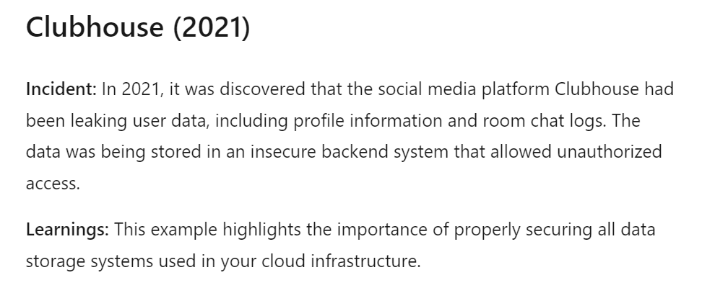
Motivation
MATRUSRI ENGINEERING COLLEGE
Department of CSE
Cloud storages are constantly under cyber attacks. Hackers are honing their methods and techniques to intrude into your cloud storage and steal your data.
As more and more companies move their data to the cloud, it is becoming increasingly important for them to understand the risks and potential consequences of cloud hacks.

Slide 5
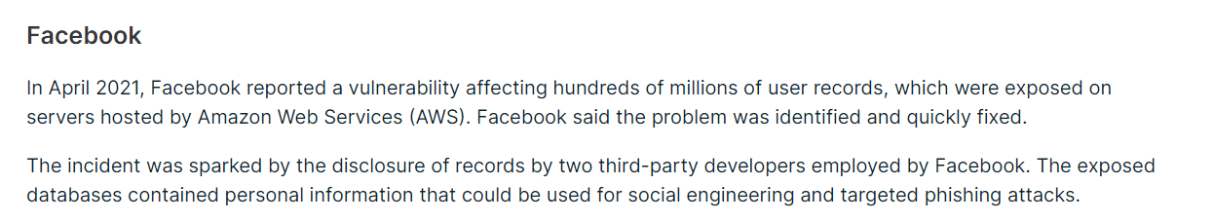
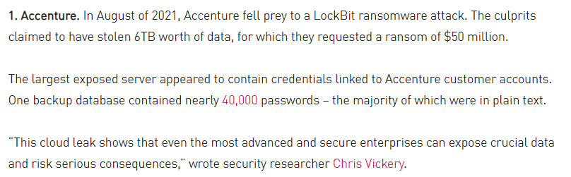
MATRUSRI ENGINEERING COLLEGE
Department of CSE
Motivation
Searching for a document on cloud which consists of millions of files, increases the retrieval rate. By using keyword search, this can be minimized.
Google search engine generates plenty of links or related information according to the keyword specified in the search bar.

Slide 6
MATRUSRI ENGINEERING COLLEGE
Department of CSE
Abstract
Introduction to a privacy-preserving mechanism for public auditing of cloud-stored data.
Utilization of innovative techniques like the AES algorithm for encryption of data, SMTP protocol for secure communication of keys, and MD5 hashing to verify data integrity.
AES algorithm uses CBC mode with PKCS5 padding and with key size of 16 bytes(128bits).
Emphasis on maintaining data integrity while safeguarding the identity of data signers.
Primary objective: To elucidate the intricacies of the mechanism and its efficiency in auditing shared data.
Contribution to the evolving landscape of cloud security through comprehensive exploration and insights.

Slide 7
Problem Statement
MATRUSRI ENGINEERING COLLEGE
Department of CSE
The advent of cloud computing has revolutionized data storage and sharing, enabling individuals and organizations to leverage scalable and cost-effective solutions. However, the outsourcing of data to the cloud introduces concerns about privacy and integrity, particularly when multiple parties collaborate on shared data.
The propose system, a privacy-preserving public auditing mechanism for shared data in the cloud. We utilized innovative techniques like the AES algorithm for encryption of data, SMTP protocol for secure communication of keys, and MD5 hashing to verify data integrity.
To improve the efficiency of verifying integrity of the data, we further extend our mechanism to use MD5 hashing algorithm.
As we delve into the technical aspects of the proposed mechanism, the report also sheds light on the underlying principles of the Advanced Encryption Standard (AES), highlighting its unconventional use of bytes instead of bits and its matrix-based computation approach.
Traceability, which means the ability for the group manager to reveal the identity of the signer based on verification metadata in some special situations.

Slide 8
Literature Survey
MATRUSRI ENGINEERING COLLEGE
Department of CSE
Year | Authors | Title | Methodology | Features | Advantages
2010 | Cong Wang, Qian Wang | Privacy-Preserving Public Auditing for Data Storage Security in Cloud Computing | Use public key-based homomorphic authenticator. Integrate random mask technique for privacy preservation. Explore bilinear aggregate signature for efficient handling of multiple auditing tasks. | Privacy-preserving public auditing system. Efficient auditing without local data copy. No additional online burden for the cloud user. | Preserves data privacy during public auditing. Enables efficient auditing without local data possession. Minimizes online burden for the cloud user
2015 | Jia Yu, Kui Ren, Cong Wang | Enabling cloud storage auditing with key-exposure resistance | Investigate key-exposure in cloud storage auditing. Formalize definition and security model. Employ binary tree structure and preorder traversal. Develop novel authenticator for forward security and blockless verifiability. | First practical solution for key-exposure in cloud storage auditing. Security proof and performance analysis provided. | Enhances security by addressing key exposure. Provides a practical solution to a new problem setting.

Slide 9
MATRUSRI ENGINEERING COLLEGE Department of CSE
Literature Survey
Year | Authors | Title | Methodology | Features | Advantages
2022 | Yongli Tang, Yanpeng Ba | Lattice-Based Public-Key Encryption with Conjunctive Keyword Search in Multi-User Setting for IIoT | Propose a lattice-based PEKS scheme. Achieve security against quantum computing attacks. Support multi-user and conjunctive keyword search. Use broadcast encryption to reduce storage cost. | Security against quantum computing attacks. Support for multi-user and conjunctive keyword search. Reduced storage cost through broadcast encryption. | Addresses quantum computing threats. Supports multi-user scenarios and conjunctive keyword search. Reduces storage costs in a multi-user setting.

Slide 10
Objectives
MATRUSRI ENGINEERING COLLEGE
Department of CSE
1. Develop an Advanced Privacy-Preserving Mechanism: Create a state-of-the-art privacy-preserving mechanism that employs cutting-edge cryptographic techniques to ensure the security and privacy of shared data in cloud environments.
2. Efficient Public Auditing: Streamline the public auditing process for shared cloud data, enhancing efficiency by enabling verifiers to assess data integrity without the need to retrieve the entire file.
3. Scalable System Architecture: Optimize the system architecture to ensure scalability, aligning hardware and software specifications to accommodate varying workloads and large datasets, thereby enhancing overall system performance.
4. Scalable Operations: Extend the mechanism to support dynamic data scenarios, including block-level operations such as modification, deletion, and insertion, ensuring the adaptability and robustness of the system in addressing evolving data challenges.
5. Enhance Security for Confidential Data Sharing: Elevate the security measures for file sharing within the proposed mechanism, ensuring robust protection against unauthorized access and data breaches while preserving the privacy of shared information.

Slide 11
MATRUSRI ENGINEERING COLLEGE
Department of CSE
Proposed Methodology
The propose system, a privacy-preserving public auditing mechanism for shared data in the cloud.
We utilize MD5 hashing algorithm, so that a public verifier is able to audit shared data integrity without retrieving the entire data, yet it cannot distinguish who is the signer on each block.
Advanced Encryption Standard algorithm for encryption of data and uses CBC mode with PKCS5 padding and with key size of 16 bytes(128bits).
SMTP stands for "Simple Mail Transfer Protocol." this can be the protocol used for secure communication between the data owners and the authorized users.
Your e-mail shopper uses SMTP to send a message to the mail server, and also the mail server uses SMTP to relay that message to the proper receiving mail server.
SMTP protocol shares the secret key from the data owner to the user to decrypt the data.
In order to create privacy-preserving mechanism we use other cryptographic techniques like encryption and decryption to ensure the security and privacy of shared data.

Slide 12
MATRUSRI ENGINEERING COLLEGE
Department of CSE
Modules
Admin: This domain must access the User Interface by providing their login credentials and the One-Time Password (OTP) generated from the database. Following the admin's login to the User Interface, they are responsible for registering all individuals involved in cloud data transfer operations, including users, data creators, and auditors.
Data Owner: The administrator is responsible for enrolling all data owners in the cloud and granting them access by assigning a username, password, and product key. The SMTP protocol facilitates the transmission of these credentials to the data owner's registered email address. Upon receipt, the Data Owner must authenticate by logging in using the provided username and password, after which they can upload encrypted files. Encryption is performed using the AES algorithm, and the encrypted files are stored securely in the cloud, accessible solely to authorized users. The uploaded files can be in various formats, such as PDF, JPG, DOC, etc., and can be sourced from any location within the system, including desktops and drives.

Slide 13
MATRUSRI ENGINEERING COLLEGE
Department of CSE
Modules
3. Auditor: All auditors who verify the accuracy of data submitted by data owners in the cloud must be registered by the administrator. Every auditor receives a login username and password from the administrator. The SMTP protocol sends these credentials to the auditor's registered email address. The auditor must use the username and password to log in after receiving it. The auditor uploads the identical file that the data owner submitted in order to confirm the integrity of the uploaded file. This approach uses hashing for verification. A distinct ID is given to each auditor who confirms the data to maintain security in the cloud environment.
4. User: The administrator is responsible for enrolling each cloud user who needs data access. The administrator assigns each user a username, password, and secret key. The SMTP protocol is then used to send these credentials to the user's registered email address. When the user receives the email, they must enter the secret key after logging in with their username and password to view the file the data owner uploaded.

Slide 14
System Requirements
MATRUSRI ENGINEERING COLLEGE
Department of CSE
Software Requirement:
Language :Java(JDK 1.7)
Operating System: Windows 7 32bit
MySQL Server: SQLyog
NetBeans IDE : 8.0.2
Hardware Requirement :
RAM : 1 GB
Hard Disk : 80 GB
Above 2GHz Processor
Data Card

Slide 15
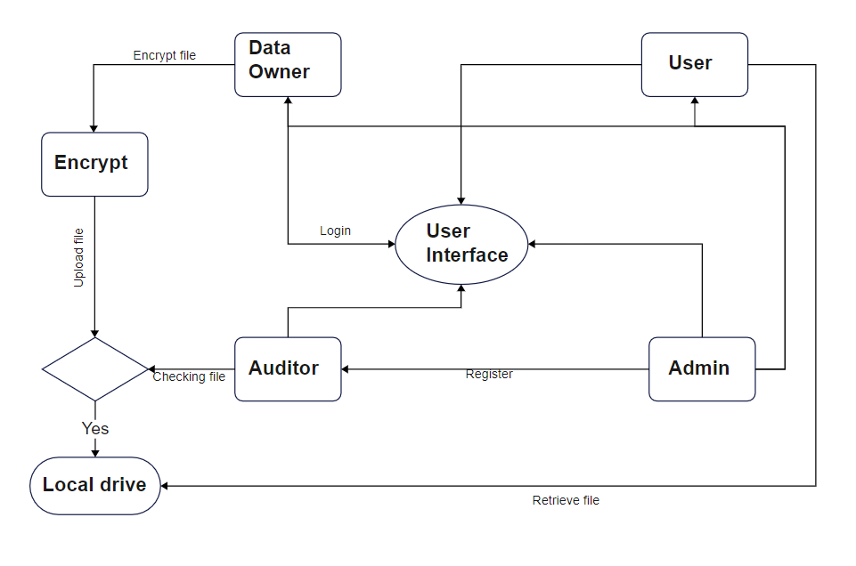
System Architecture
MATRUSRI ENGINEERING COLLEGE
Department of CSE

Slide 16
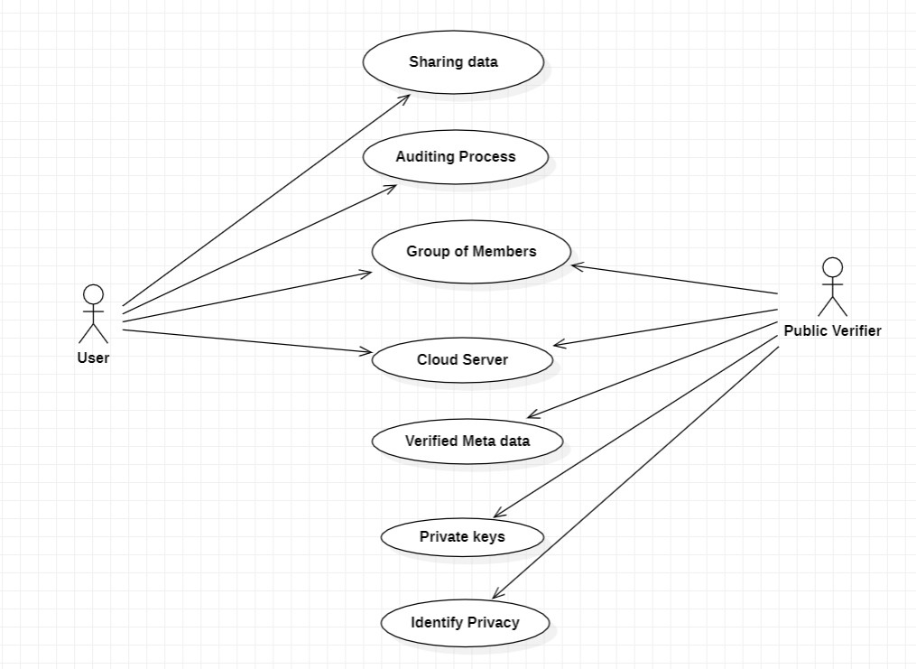
Use case Diagram
A use case diagram at its simplest is a representation of a user's interaction with the system that shows the relationship between the user and the different use cases in which the user is involved.

Slide 17
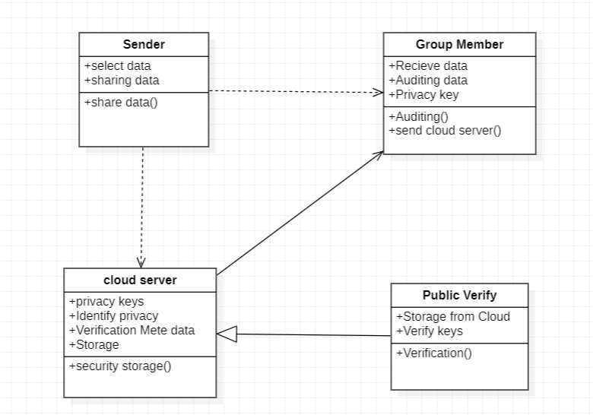
Class Diagram
The class diagram in the Unified Modelling Language (UML) is a type of static structure diagram that describes the structure of a system by showing the system's classes, their attributes, operations (or methods), and the relationships among objects.

Slide 18
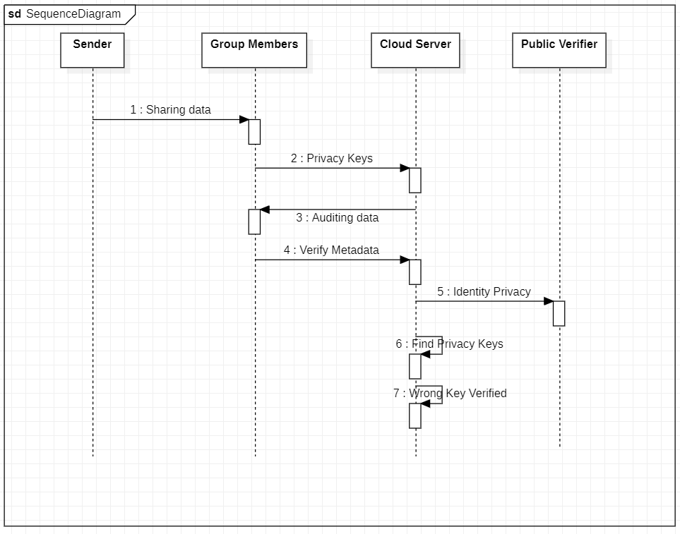
Sequence Diagram
A sequence diagram shows object interactions arranged in time sequence. It depicts the objects and classes involved in the scenario and the sequence of messages exchanged between the objects needed to carry out the functionality of the scenario.

Slide 19
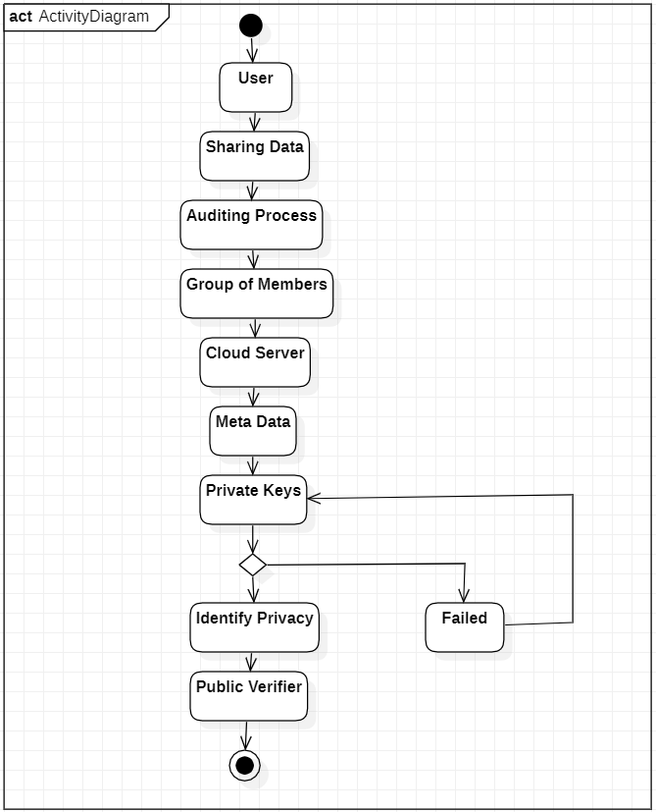
Activity Diagram
In UML, an activity diagram is used to display the sequence of activities. Activity diagrams show the workflow from a start point to the finish point detailing the many decision paths that exist in the progression of events contained in the activity.

Slide 20
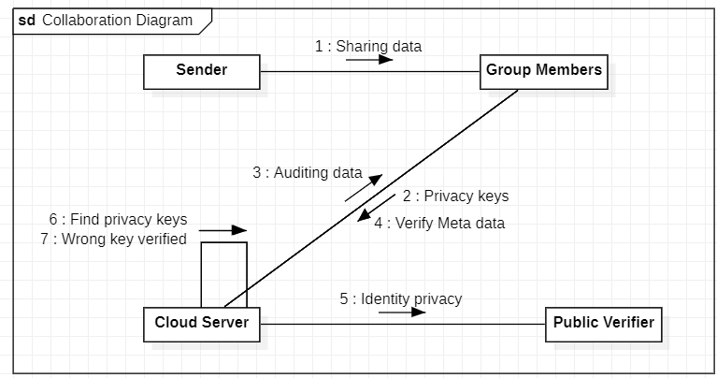
Collaboration Diagram
A collaboration diagram resembles a flowchart that portrays the roles, functionality and behavior of individual objects as well as the overall operation of the system in real time.

Slide 21
Data Flow Diagram Level-0
User
Encrypted file
Upload file
Server
Download file
Retrieve original file

Slide 22
Data Flow Diagram Level-1
User
Encrypted file
Upload file
Server
Public verifier
Download file
Public Auditing
Retrieve original file

Slide 23
Data Flow Diagram Level-2
User
Encrypted file
Upload file
Server
Public verifier
Download file
Public Auditing
Homomorphic signature
Retrieve original file

Slide 24
Algorithms
MATRUSRI ENGINEERING COLLEGE
Department of CSE
Advanced Encryption Standard (AES):
Efficient Symmetric Encryption: AES offers efficient symmetric encryption, operating on entire blocks of data simultaneously rather than individual bits, enhancing its performance and robustness.
Flexible Key Lengths: AES supports key lengths of 128-bit, 192-bit, and 256-bit, providing flexibility to adapt to varying security requirements and ensuring scalability for different applications.
Matrix-Based Computation: AES employs a matrix-based computation approach, organizing plaintext blocks into a four-column, four-row matrix format, facilitating streamlined encryption and decryption processes.
Confidentiality and Security: By utilizing AES for encryption and decryption of shared data, the project ensures confidentiality and security, safeguarding sensitive information from unauthorized access and enhancing the overall integrity of the proposed privacy-preserving mechanism for cloud storage systems.

Slide 25
Algorithms
MATRUSRI ENGINEERING COLLEGE
Department of CSE
Simple Mail Transfer Protocol (SMTP):
Facilitates Secure Communication: SMTP plays a crucial role in facilitating secure communication between computers and smartphones, serving as the backbone for transmitting messages efficiently and securely.
Key Exchange and Authentication: SMTP is utilized for key exchange and receiving login details, ensuring secure authentication and enabling businesses to securely access their email accounts and communicate with their networks.
Ease of Configuration: Setting up SMTP involves gathering essential information such as host name, port, SSL authentication details, and account credentials, followed by configuring SMTP settings, making it easy for businesses to establish reliable email communication channels.
Reliability and Compatibility: Leveraging SMTP for email communication offers reliability, efficiency, and compatibility, allowing businesses to effectively convey information, engage with their audience, and conduct email marketing campaigns with ease and confidence.

Slide 26
Algorithms
MATRUSRI ENGINEERING COLLEGE
Department of CSE
Message Digest 5 (MD5) hashing:
MD5 is a widely used cryptographic hash function that produces a 128-bit hash value. And is commonly used for data integrity checks, digital signature and checksums to verify data integrity.
Checksum Comparison: MD5 generates a fixed-size hash value for input data, which can be compared with a previously calculated MD5 hash of the same data. If the hashes match, it's highly likely that the data hasn't been tampered with.
Efficiency: MD5 is relatively fast and computationally efficient, making it suitable for tasks where quick verification of data integrity is required.
Vulnerabilities: MD5 is susceptible to collision attacks, where different inputs can produce the same hash output. This weakness undermines its reliability for cryptographic purposes and necessitates caution when using it for data integrity verification, especially in security-sensitive applications.
Usage: MD5 is still used in various applications such as checksums for file verification, integrity checks in version control systems, and as a checksum in integrity verification mechanisms for software distribution.

Slide 27
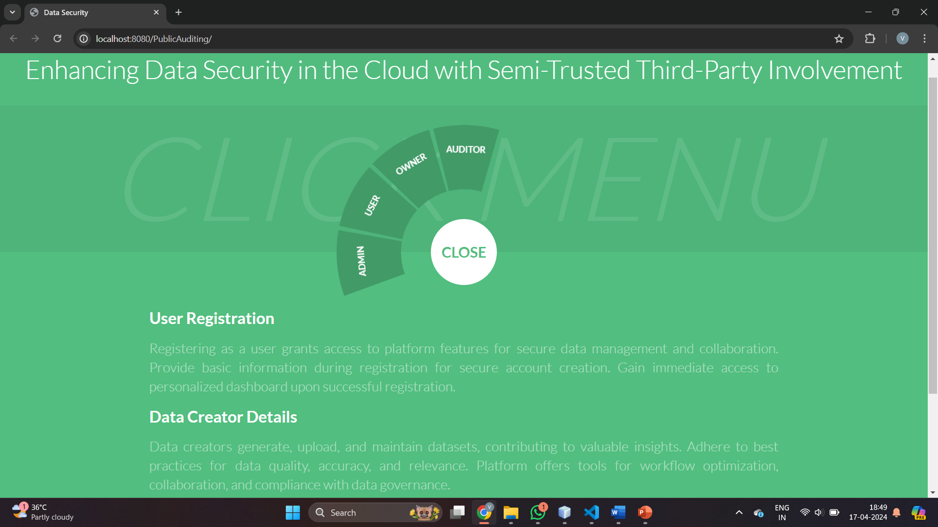
Results

Slide 28
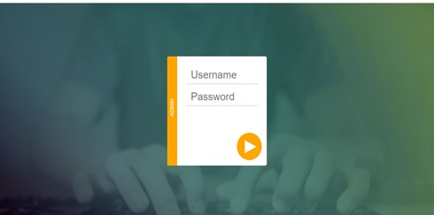
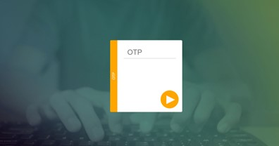
Admin Login Page

Slide 29
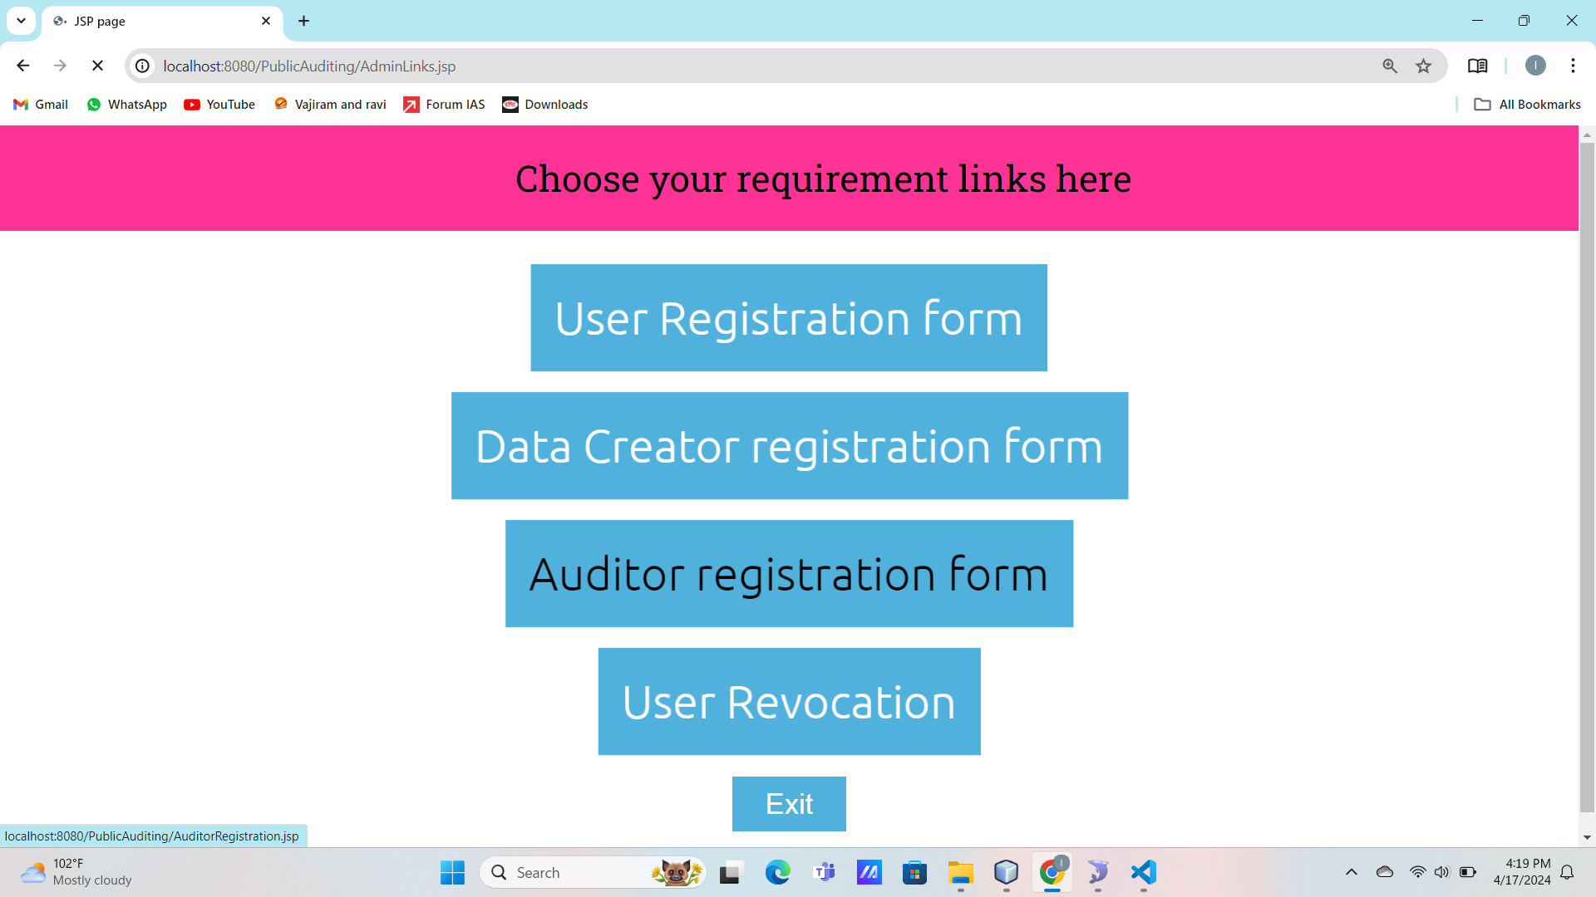
Registration Forms

Slide 30
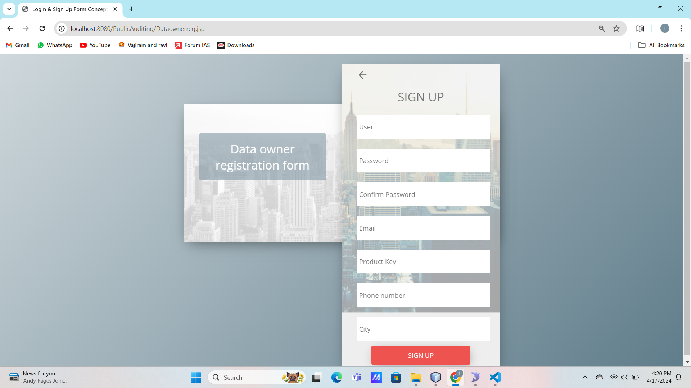
Data Owner Registration Form

Slide 31
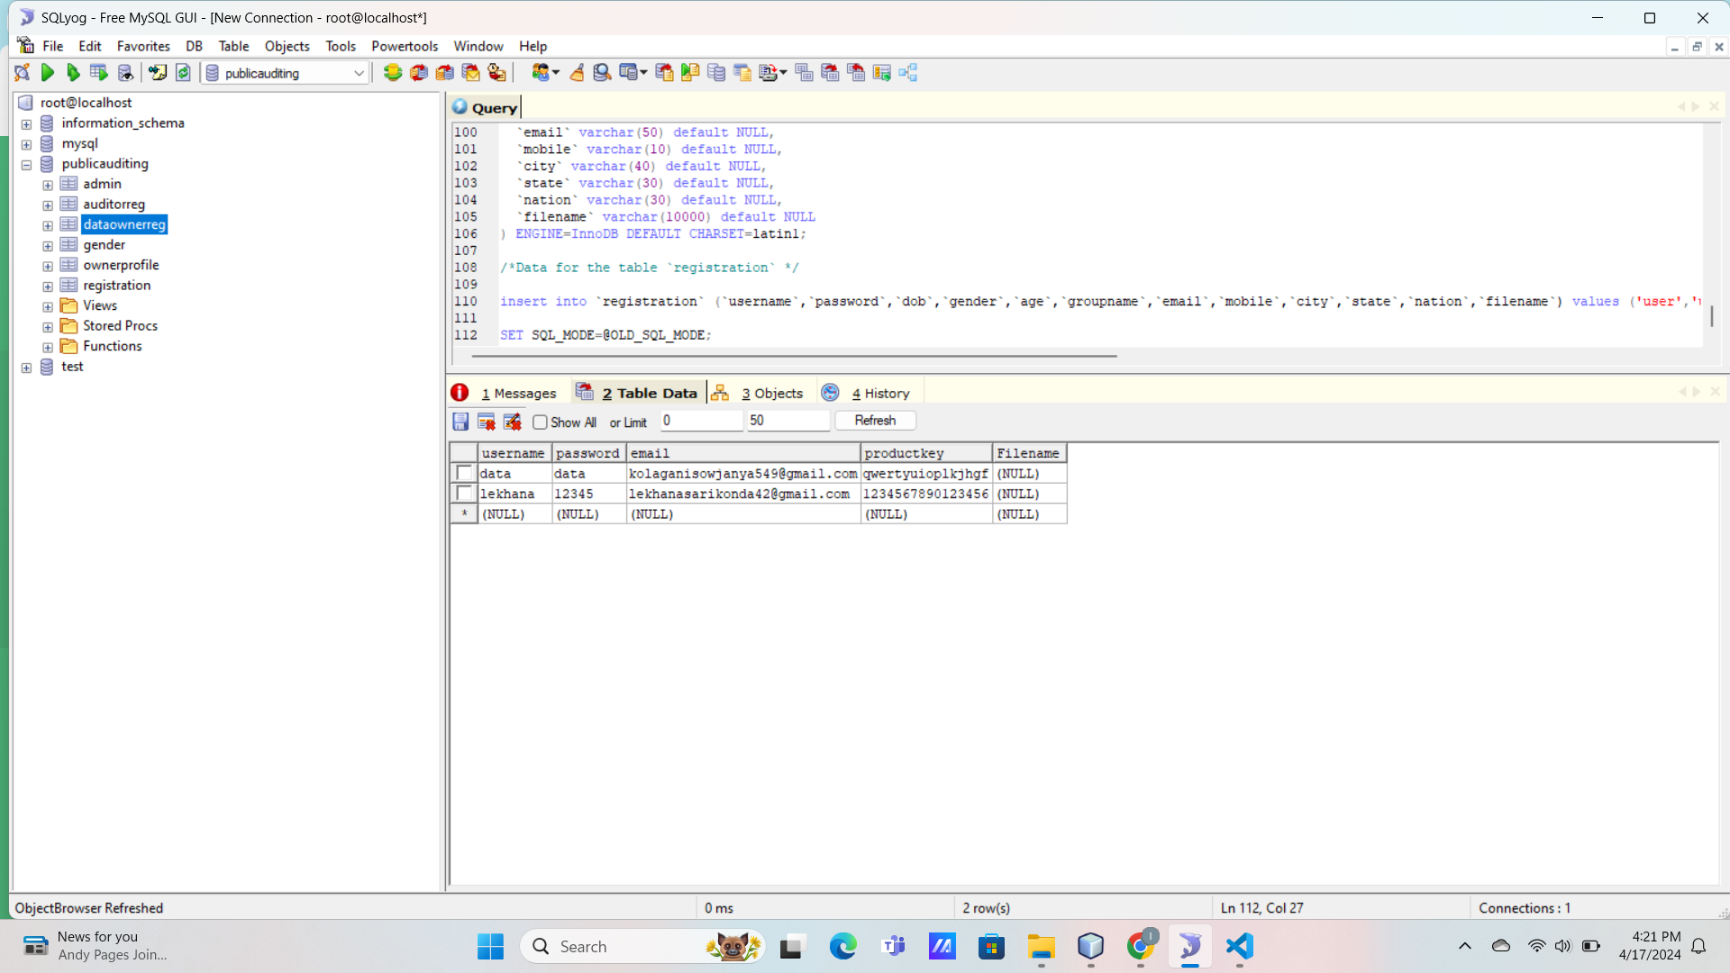
Data Owner Details in Database

Slide 32
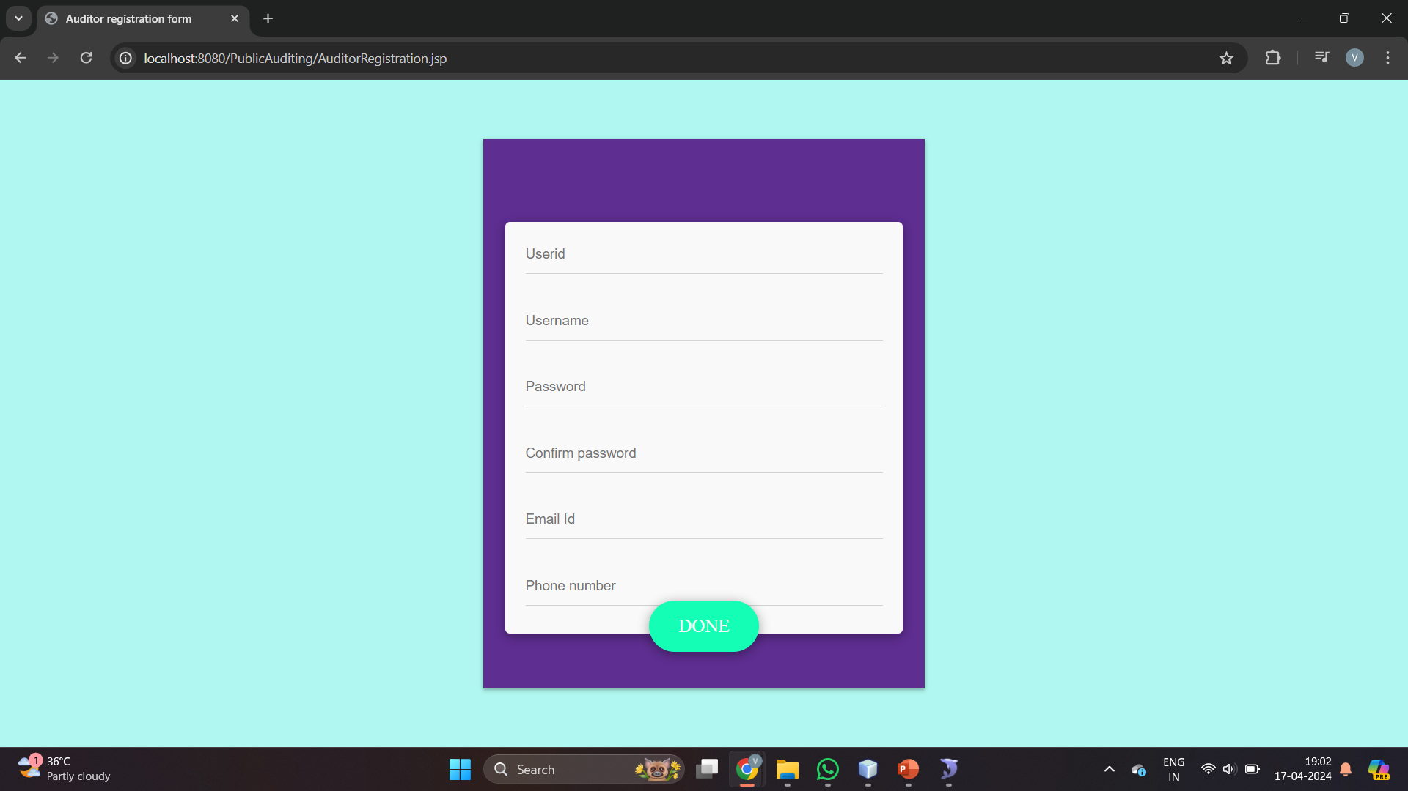
Auditor Registration Form

Slide 33
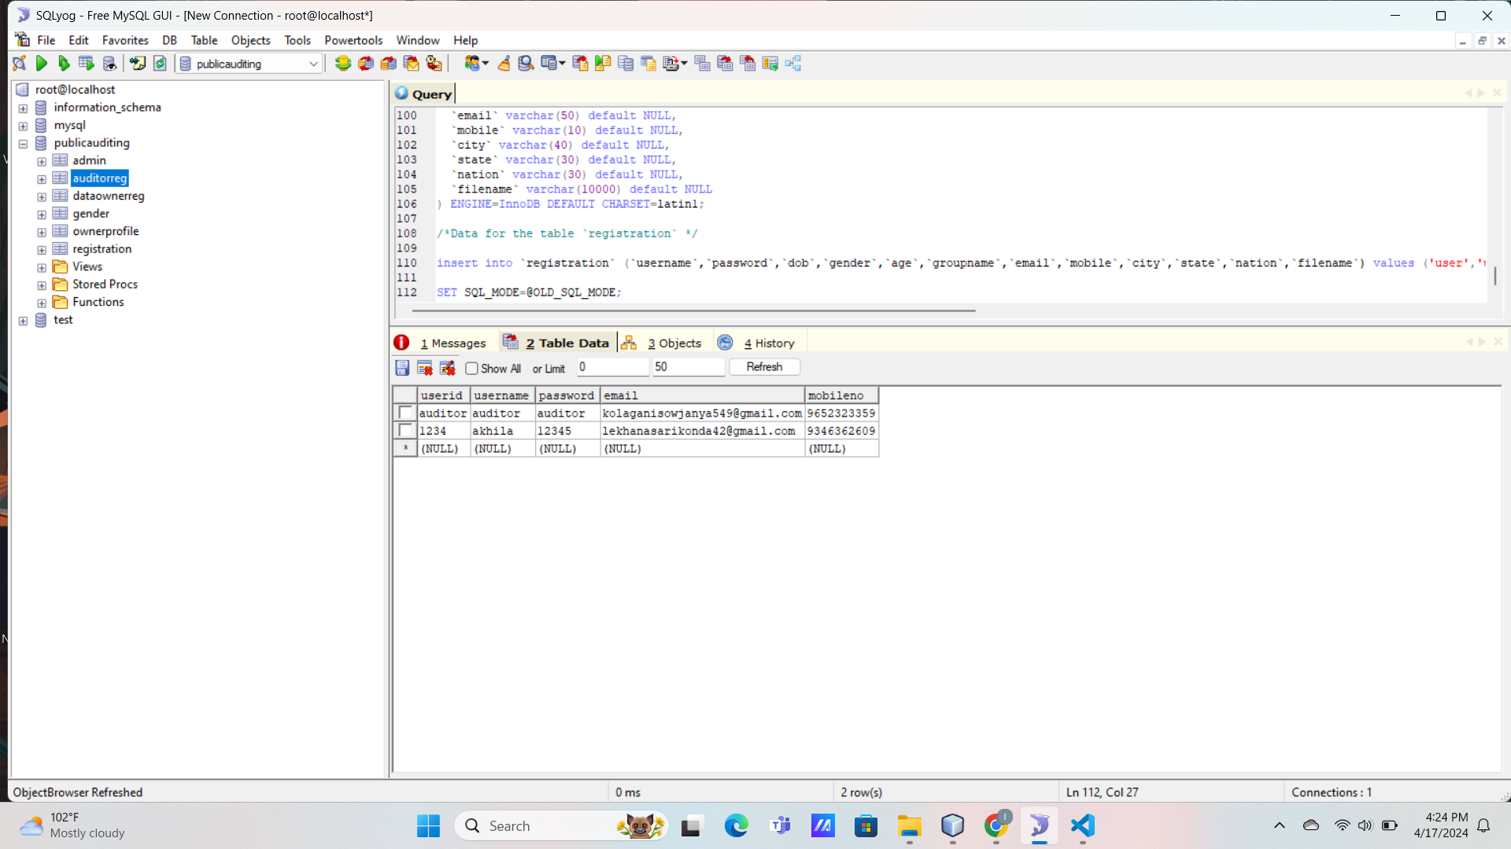
Auditor Details in Database

Slide 34
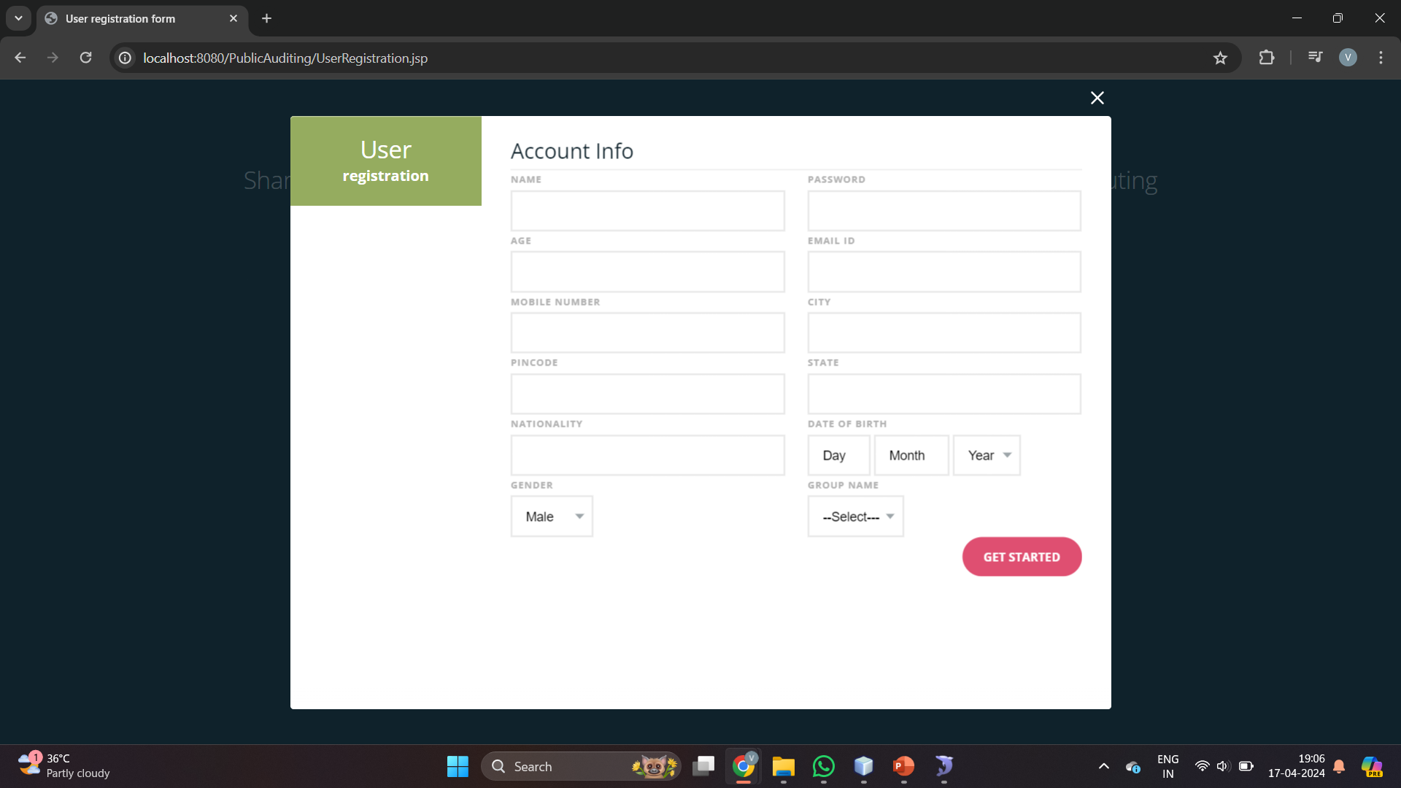
User Registration Form

Slide 35
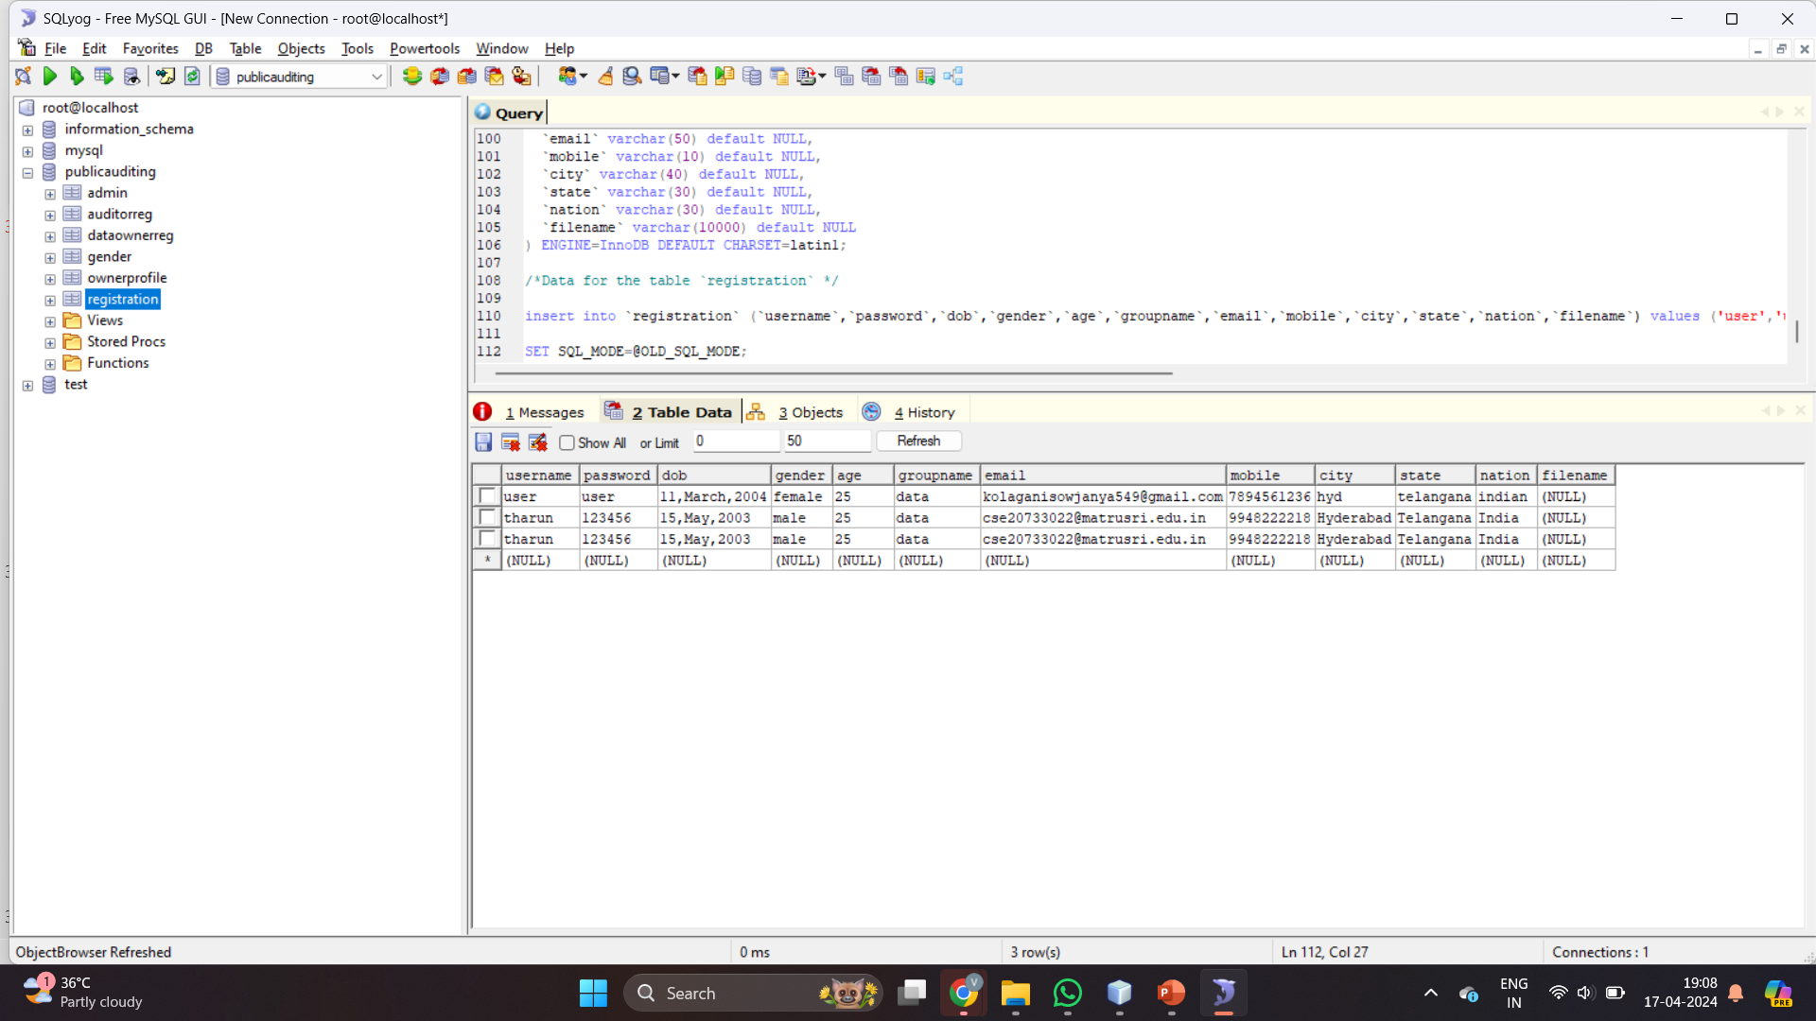
User Details in Database

Slide 36
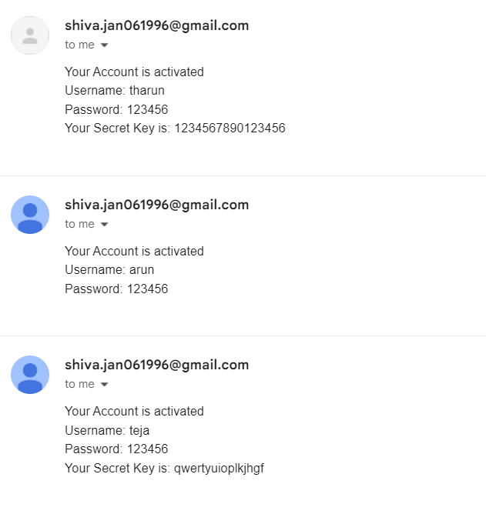
Received Mails

Slide 37


Data Owner Login and Upload File

Slide 38
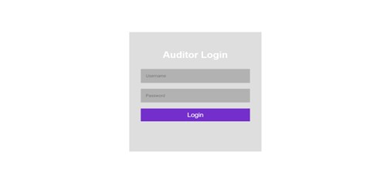

Auditor Login and Check File

Slide 39


User Login and Enter Secret Key

Slide 40
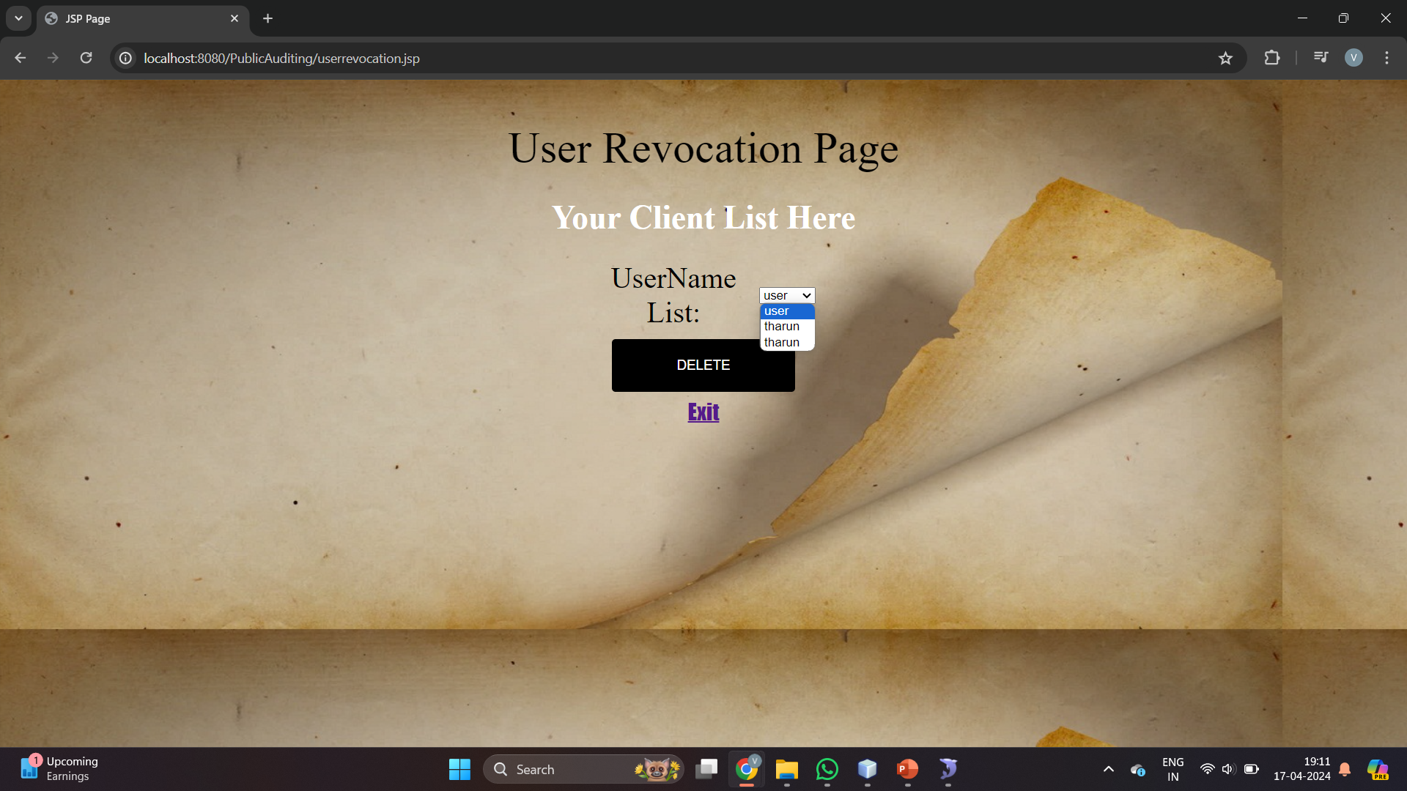
Delete Users

Slide 41
Conclusion
MATRUSRI ENGINEERING COLLEGE
Department of CSE
In the rapidly evolving landscape of cloud computing, the proposed privacy preserving mechanism stands as a pivotal advancement in fortifying the security of shared data.
The proposed mechanism implements cutting-edge cryptographic techniques to enhance data security in cloud computing.
The integration of innovative cryptographic techniques ensures a heightened level of security, mitigating the risk of identity privacy leakage that has been a prevalent concern in existing mechanisms.
In essence, the proposed mechanism not only meets the current demands for secure shared data but also lays the groundwork for an adaptive and forward-thinking solution that anticipates and addresses the evolving challenges in cloud-based information management.

Slide 42
References
MATRUSRI ENGINEERING COLLEGE
Department of CSE
[1]. J. Yu, K. Ren, C. Wang, and V. Varadharajan, “Enabling cloud storage auditing with key-exposure resistance,” Information Forensics and Security, IEEE Transactions on, vol. 10, no. 6, pp. 1167–1179, 2015.
[2]. R. S. Bali and N. Kumar, “Secure clustering for efficient data dissemination in vehicular cyberphysical systems,” Future Generation Computer Systems, pp. 476–492, 2016.
[3]. S. Zarandioon, D. D. Yao, and V. Ganapathy, “K2c: Cryptographic cloud storage with lazy revocation and anonymous access,” in International Conference on Security and Privacy in Communication Systems. Springer, 2011, pp. 59–76.
[4]. C. Wang, Q. Wang, K. Ren, and W. Lou, “Privacy-preserving public auditing for data storage security in cloud computing,” in 2010 proceedings ieee infocom. IEEE, 2010, pp. 1–9.
[5]. M. Ali, R. Dhamotharan, E. Khan, S. Khan, A. Vasilakos, K. Li, and A. Zomaya, “Sedasc: Secure data sharing in clouds,” IEEE Systems Journal, vol. 11, no. 2, pp. 395–404, 2017.

